Slide 1
Configure a Firewall in Linux
Utilizing the built-in Linux application firewall Iptables or UFW, set up and create rules to actively filter networking packets and block specific ports.

Slide 2
A firewall is a network security device or software application that monitors and controls incoming and outgoing network traffic based on predetermined security rules. its primary purpose is to establish a barrier between a trusted internal network (such as a company's intranet) and untrusted external networks (like the internet), thereby regulating the flow of data packets to prevent unauthorized access and attacks.
What is Firewall

Slide 3
Hardware firewalls: Typically integrated into network hardware devices such as routers or dedicated firewall appliances. they provide robust protection at the network level and are often used to protect entire networks or segments of a network.
Software firewalls: Installed on individual computers or servers, software firewalls offer protection at the operating system or application level. they are particularly useful for protecting specific devices or endpoints from unauthorized access.
Cloud firewalls: Deployed in cloud environments to protect virtual servers and applications running in the cloud. cloud firewalls provide scalable security measures tailored to cloud-based infrastructure and applications.
Types of Firewalls

Slide 4
In the context of firewalls, terminology refers to specific terms and concepts that are used to describe their functionality, features, configuration, and operation. understanding firewall terminology is crucial for effectively implementing, managing, and troubleshooting these network security devices.
Features: Terminal emulators like "terminology" often come with features beyond basic terminal functionalities. these may include support for multiple tabs, customizable themes, transparency, and various keyboard shortcuts.
Terminology

Slide 5
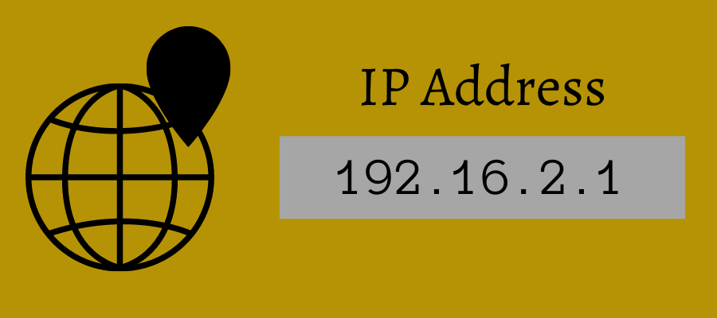
An IP address, short for internet protocol address, is a numerical label assigned to each device connected to a computer network that uses the internet protocol for communication.
IP Address

Slide 6
IPV4 (internet protocol version 4): This is the older and most widely used type of ip address. it consists of four sets of numbers separated by periods (e.g., 192.168.0.1). ipv4 addresses are gradually being exhausted due to the increasing number of devices connected to the internet.
IPV6 (internet protocol version 6): Ipv6 addresses are newer and designed to replace ipv4. they are longer and written in hexadecimal format (e.g., 2001:0db8:85a3:0000:0000:8a2e:0370:7334). ipv6 provides a much larger pool of addresses, ensuring the continued growth of the internet.
There are two main types of IP addresses:

Slide 7
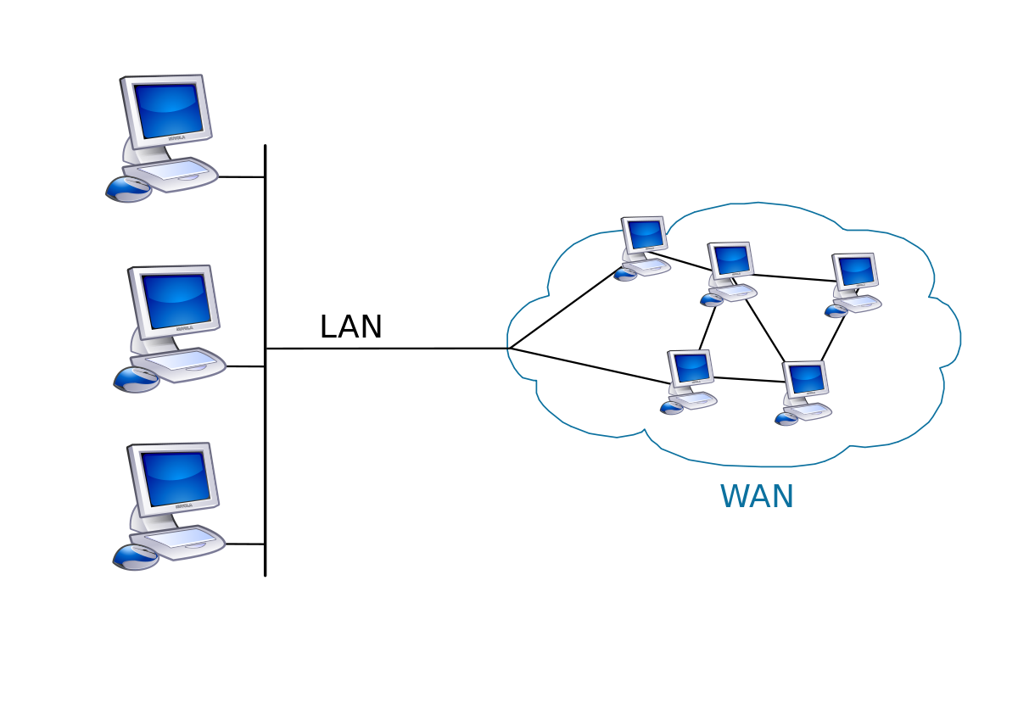
WAN stands for wide area network. it is a type of computer network that spans a large geographical area, typically across cities, countries, or even continents. unlike local area networks (LANS), which are confined to a single location such as a home, office building, or campus, wans connect multiple LANS together using various technologies to facilitate communication over long distances.
WAN

Slide 8
Corporate networks: Many large organizations use WANs to connect their branch offices, data centers, and remote workers into a unified network infrastructure.
Internet: The global internet itself is the largest wan, connecting billions of devices and networks worldwide.
Telecommunication networks: Telecommunication companies use WANs to provide services like internet access, telephone communication, and video conferencing over vast distances.
Examples of WAN applications:

Slide 9
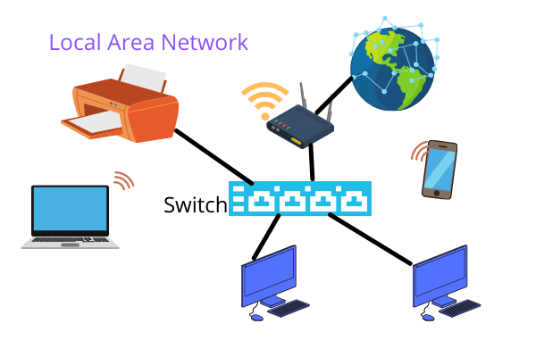
LAN stands for local area network. it refers to a computer network that spans a relatively small area, typically within a single building, office, campus, or group of buildings that are close together. LANS are designed to facilitate communication and resource sharing among devices and users within the same geographical location.
LAN

Slide 10
Home network: A home network is a lan used within a residence to connect personal devices such as computers, laptops, smartphones, tablets, smart tvs, and printers. it allows family members to share internet access, files, printers, and other resources. Small Business Network: Small businesses use LANs to connect computers, printers, and other devices in their offices. This allows employees to share files, access shared databases and software applications, and collaborate on projects more efficiently. Gaming LAN: LANs are also popular in gaming environments, where gamers connect their computers or gaming consoles together to play multiplayer games locally without relying on internet connections. LAN parties or gaming events often utilize LAN setups for multiplayer gaming.
Examples of LAN applications:

Slide 11
Internet traffic refers to the data transmitted over the internet between devices, networks, or servers. there are several types of internet traffic, each serving different purposes and utilizing various protocols like exchange of data(web browsing, email communication, multimedia streaming).
Internet Traffic

Slide 12
TCP (transmission control protocol): TCP is a connection-oriented protocol used for reliable and ordered delivery of data. it is widely used by applications that require guaranteed delivery of packets, such as web browsing, email, file transfer (ftp), and ssh.
UDP (user datagram protocol): UDP is a connectionless protocol that offers faster transmission with no error checking or retransmission of lost packets. it is used for applications where real-time communication and speed are more critical than reliability, such as VOIP (voice over IP), streaming media, DNS (domain name system), and online gaming.
ICMP (internet control message protocol): ICMP is primarily used for diagnostic or control purposes within IP networks. it includes functions such as ping (echo request/reply), traceroute, and network error reporting (e.g., destination unreachable).
HTTP (hypertext transfer protocol): Http is the foundation of data communication for the world wide web. it is used for retrieving web pages and transmitting data between a web server and a web browser.
Some common types of internet traffic in Linux include:

Slide 13
HTTPS (http secure): Https is the secure version of http, encrypted with ssl/tls, which provides secure communication over a computer network.
DNS (domain name system): DNS is used to translate domain names (e.g., www.example.com) into ip addresses (e.g., 192.0.2.1) required for routing packets of data over the internet.
FTP (file transfer protocol): Ftp is used for transferring files between a client and a server on a computer network, typically for uploading and downloading files.
SSH (secure shell): SSH is a cryptographic network protocol for operating network services securely over an unsecured network. it provides a secure channel over an unsecured network in a client-server architecture, connecting an ssh client application with an ssh server.

Slide 14
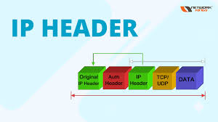
The IP header (internet protocol header) is a fundamental component of the IP (internet protocol) suite, specifically in IPV4 and IPV6. it is a data structure that precedes the actual data payload of an ip packet and contains essential information necessary for routing and delivering packets across networks.
IP header

Slide 15
Version: specifies the version of the internet protocol being used (ipv4 or ipv6).
Header length: indicates the length of the ip header in 32-bit words.
Type of service (tos): originally used for quality of service (qos) markings, but often now used for differentiated services code point (dscp) markings.
Total length: total length of the ip packet (header + data).
Identification: a unique number assigned to each ip packet to aid in reassembly of fragmented packets.
Flags: control flags used for fragmentation. includes fields like "don't fragment" (df) and "more fragments" (mf).
The IP header typically includes and its significance:

Slide 16
Fragment offset: Specifies the offset of the data in the original IP packet, used for reassembling fragmented packets.
Time to live (ttl): Limits the lifetime of an IP packet by decrementing on each hop (router) it passes through. prevents packets from circulating indefinitely.
Protocol: Indicates the protocol that is carried in the data portion of the IP packet (e.g., TCP, UDP, ICMP).
Header checksum: A checksum calculated over the IP header to detect errors in the header itself.
Source IP address: IP address of the sender (source) of the packet.
Destination IP address: IP address of the intended recipient (destination) of the packet.

Slide 17
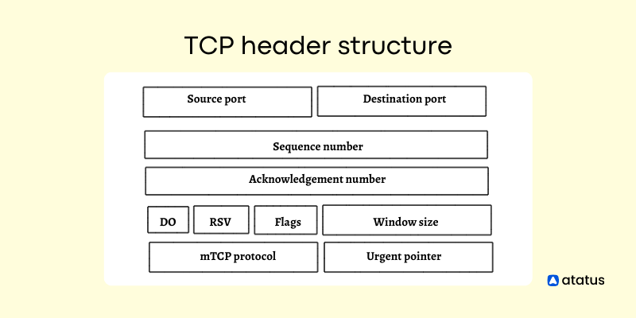
The TCP header (transmission control protocol header) is a critical component of the TCP/IP protocol suite, used for communication over the internet and other computer networks. TCP provides reliable, ordered, and error-checked delivery of data between applications running on hosts connected through a network.
TCP header

Slide 18
Source port: A 16-bit field indicating the sender's port number.
Destination port: A 16-bit field indicating the receiver's port number.
Sequence number: A 32-bit field specifying the byte sequence number of the first data byte in the current segment.
Acknowledgment number: A 32-bit field used when the ack flag is set, indicating the next sequence number that the sender of the ack expects to receive.
Data offset: A 4-bit field indicating the number of 32-bit words in the TCP header (also called the length of the TCP header in 32-bit words).
Reserved: a 6-bit field reserved for future use. it should be set to zero.
Flags: A6-bit field containing control flags such as URG(urgent pointer), ACK (acknowledgment), PSH (push), RST (reset), SYN (synchronize sequence numbers), and fin (finish).
Checksum: A 16-bit field used for error-checking the header and data.
The TCP header typically includes the following fields:

Slide 19
OSI Model

Slide 20
1)Firewalls are crucial for network security. 2)Firewalls filter traffic based on rules and operate at various OSI layers. 3)Internet traffic types like HTTP,FTP and DNS require specific configuration. 4)Tools like iptables and nftables are used in Linux. 5)Best practices include regular updates, monitoring and policy reviews.
Conclusion

Slide 21


